Slide 1
CESR Quadrupoles at Low Currents
Scope Traces
  Duty cycle at low command 1kcu
  Compare 17kHz to 4kHz at 10kcu
Histograms
  OSC save set
  500cu quads cesr east
Quadrupole 33E performance at 4kHz and 17kHz chopper clock frequencies.
Conclusion

Slide 2
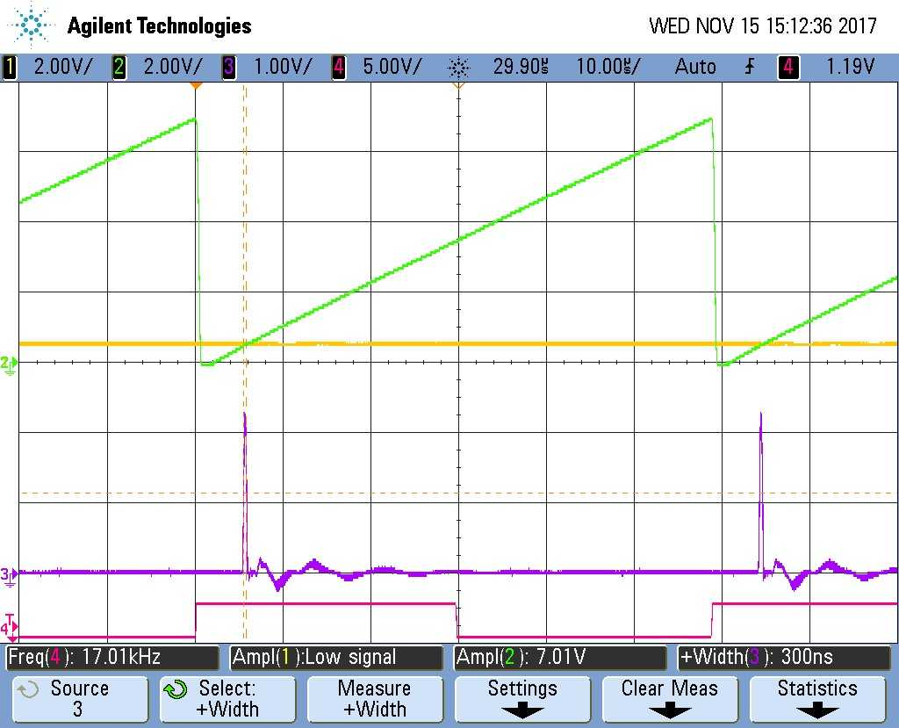
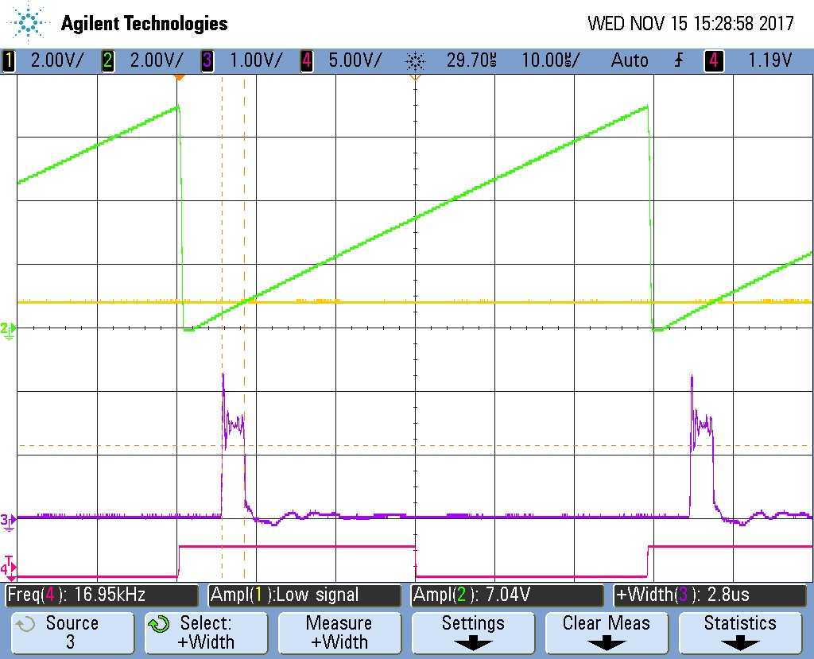
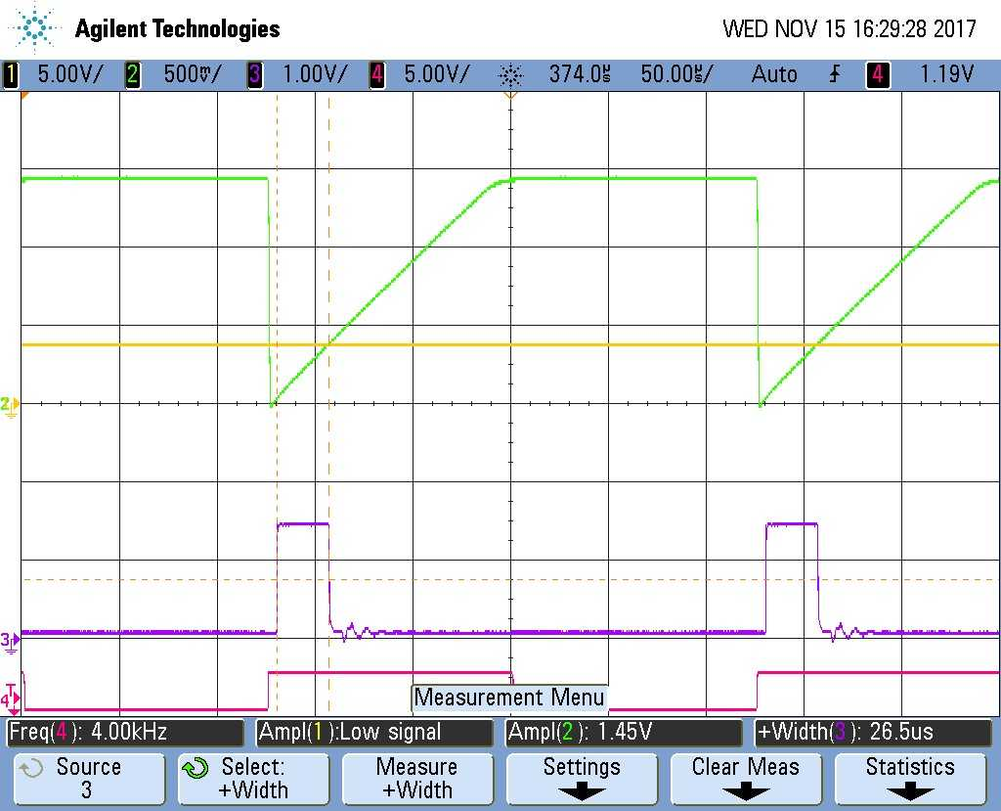
Normal chopping frequency (17kHz)
Low Command (1000cu)
At even lower commands, “on time pulses” (purple) get smaller and smaller with more uncertainty.
Control gets compromised
Stability most likely effected
No longer viable
Compare cmd of 10kcu at 17kHz and 4kHz
“on time” pulses from 3uS to 25uS
Notice scope at 10uS and 50uS/div
Huge difference in chopper “on time”
This is the advantage to lower frequency.

Slide 3
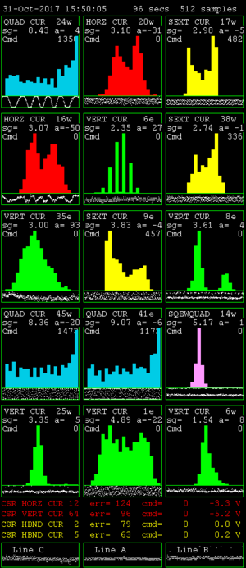
Regulation Histograms for CESR magnets
Magnet error monitor program.
This program looks at all cesr magnets and displays the “worst” case regulation in all magnet types.
Blue/quads, Red/horizontal, Green/vertical, Yellow/sextupole, Pink/skew.
Conditions here are from OSC save set, first try from couple weeks ago.
For now, only pay attention to the Blue images. Quadrupoles at normal Chopping frequency of 17kHz
Q24W, Q45W, Q41E
Commands are 1350cu, 1470cu, 1170cu (1.5 to 2Amps)
Typical commands for CHESS (5.3gev) 20kcu (approx. 30Amps)
So commands of many kcu are far enough away from the trouble area that they are just not a problem

Slide 4
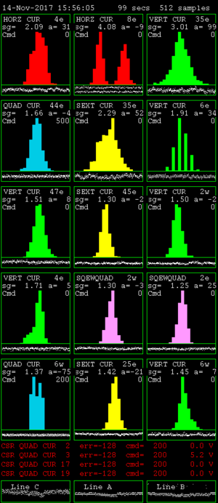
From this past Tuesday
Ran east Qbus only, Quads only.
500cu command (lower than the lowest OSC)
4kHz chopping frequency
Worst of the East is Q44E
It’s histogram looks completely normal.
This says that the rest of the quads in the east are as normal or better.

Slide 5
CESR Quadrupole 33E

Slide 6
CESR Quadrupole 33E

Slide 7
CESR Quadrupole 33E

Slide 8
Conclusion:
Need to do another test.
Therefore need more global diagnostics for full ring test.
At this point, the belief is that steering type ps’s are very good to zero command (they will be checked with the next test).
Higher current ripple with lower chopper clock.
Although may not be an issue from a field point of view.
4kHz is well within audible range (more wear and tear?). Depending on current, you can really hear it.

